Slide 1
Generating noisy speech data from clean data in the frequency domain using Deep Learning Methods
Week – 21
Name: Shashank Shirol
University: Manipal Institute of Technology
Duration of the presentation: ~10 mins.

Slide 2
Tasks to be completed:
Explore the reason behind the model learning a wrong mapping between male-female speakers:
Under this, experimented with three channels – F, G, H.
Used a single speaker in the data-set to train.
Also studied the effect of normalizing the data before training and also impact of using parallel data.
Wrote up a rough draft of the potential paper:
Structured the content in a way to tell a story.
Created illustrations/graphics to be used in the paper.
Devised potential experimental setups that could be used to substantiate the effectiveness of the proposed method.

Slide 3
Further Experiments with CUT
Here, to find the underlying reason for CUT to learn a “bad” mapping between male-female speakers, we train CUT with files from a SINGLE speaker to see if results improve.
We train CUT with channels F, G, H of the RATS corpus.
We conduct a total of 6 experiments:
Three experiments with the following options:
Domain A: clean samples Domain B: channel {F,G,H} noisy Content: different Normalization: Yes
Three experiments with the following options:
Domain A: clean samples Domain B: channel H noisy content: {different, same} Normalization: {Yes, No}

Slide 4

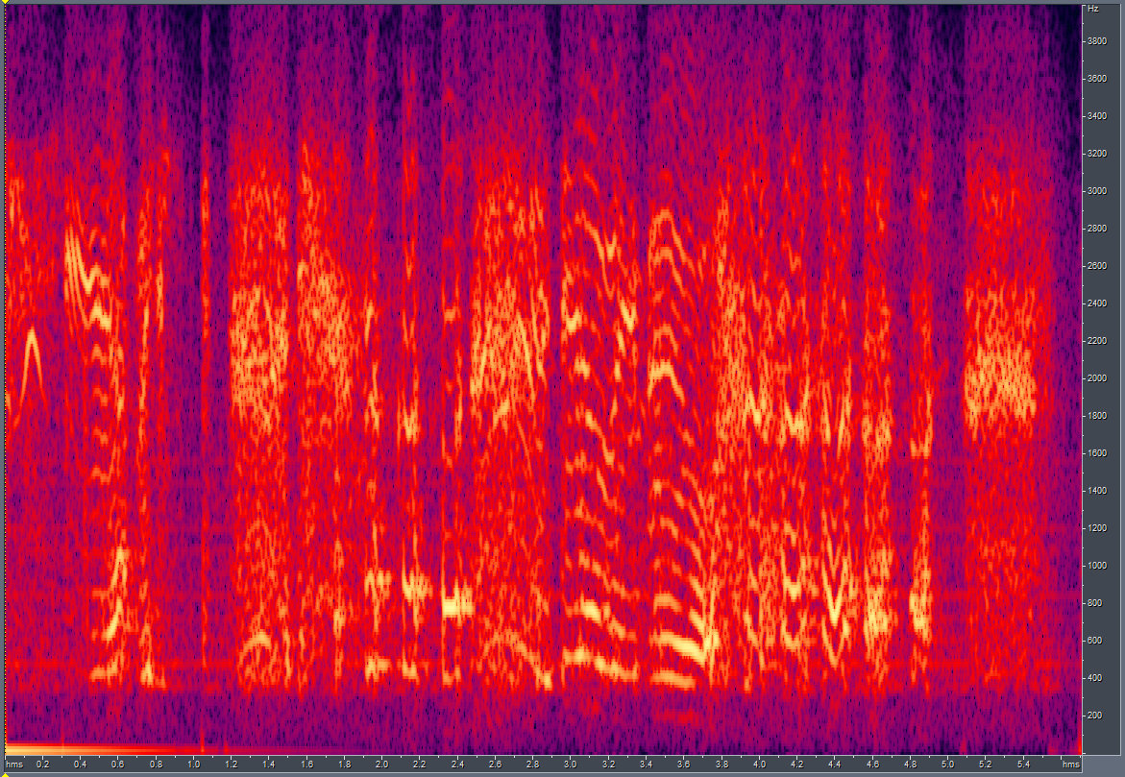
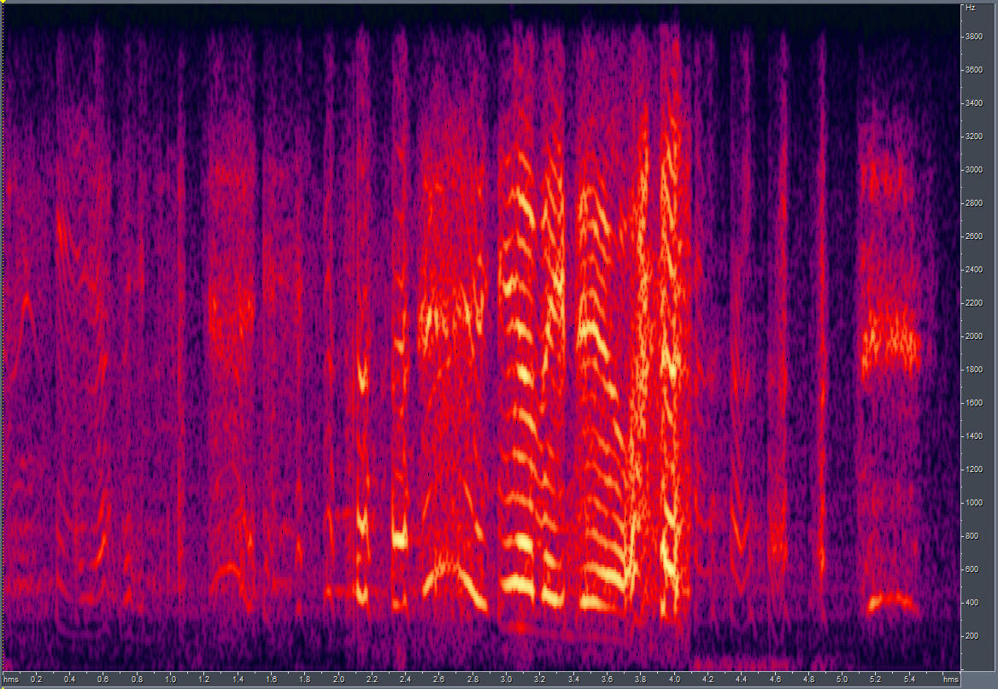
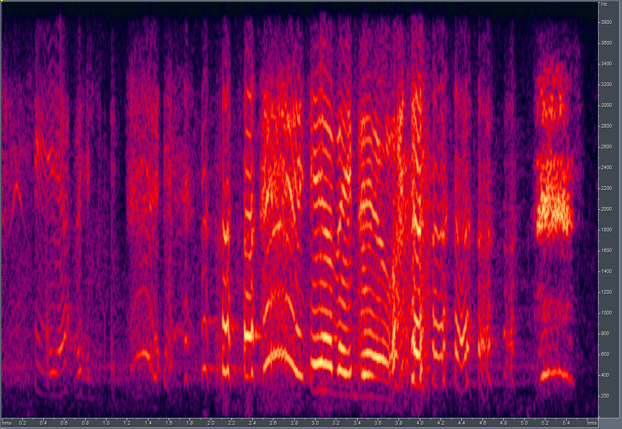
Results of the experiments (I):
Using a single-speaker dataset did not vary the results significantly. Whiles LSD scores for some samples improved, for others it worsened.
Results:
Channel F
LSD (Before): 12.26; LSD (New): 12.42
GT
O/P – same speaker
O/P – OLD
GT
O/P – same speaker
O/P – OLD

Slide 5
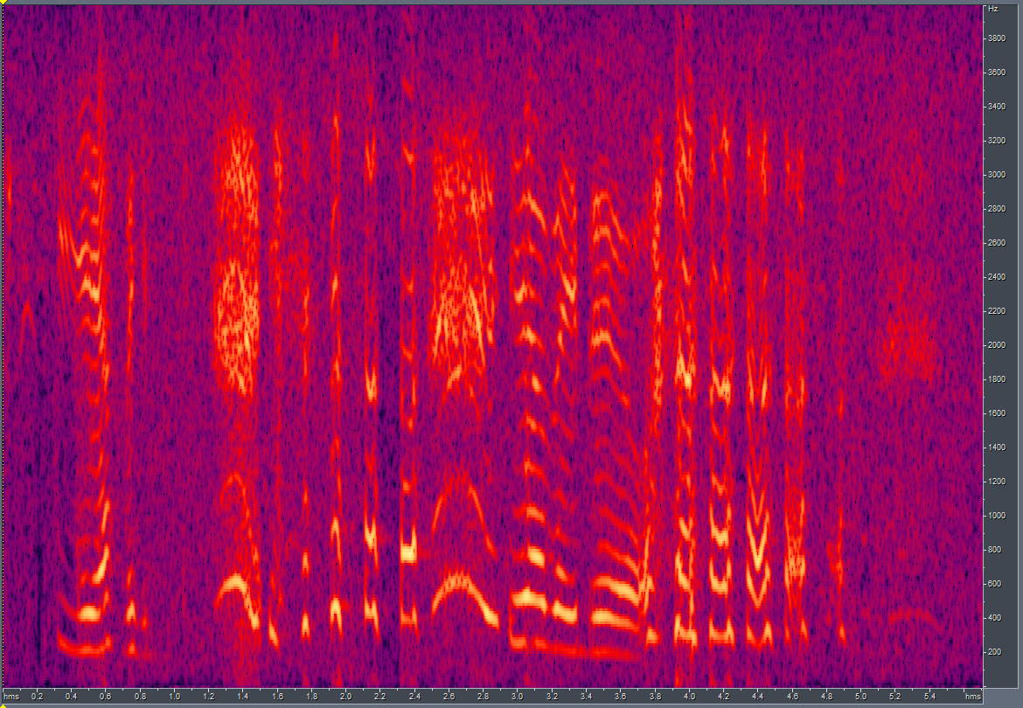
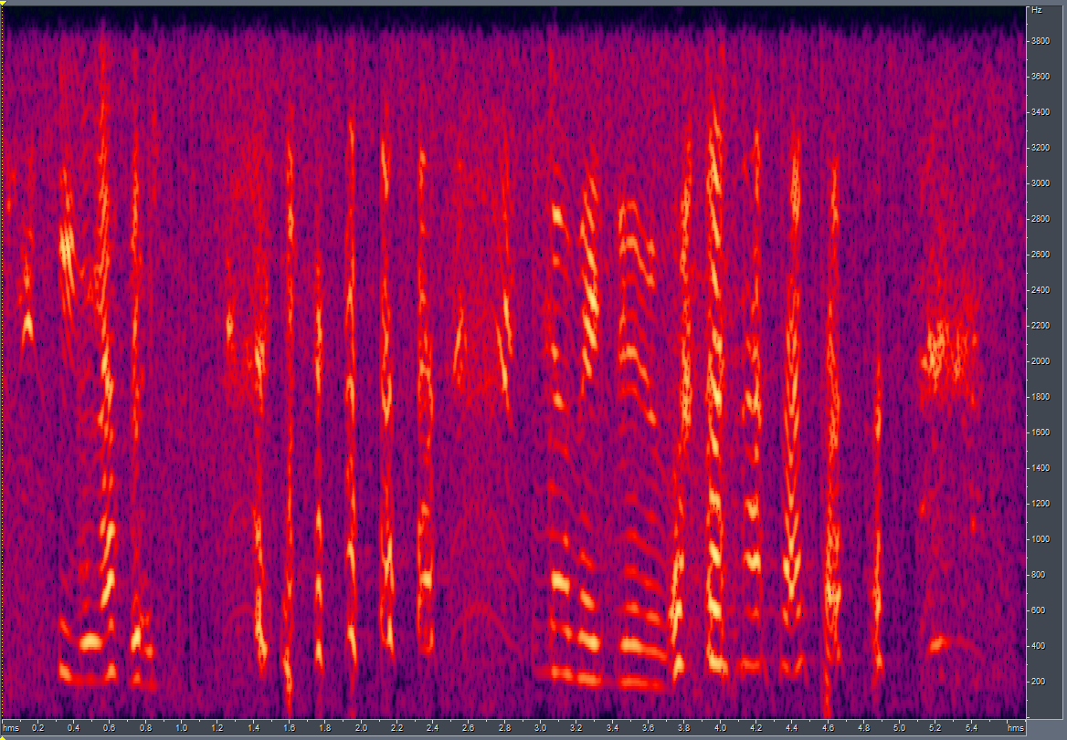
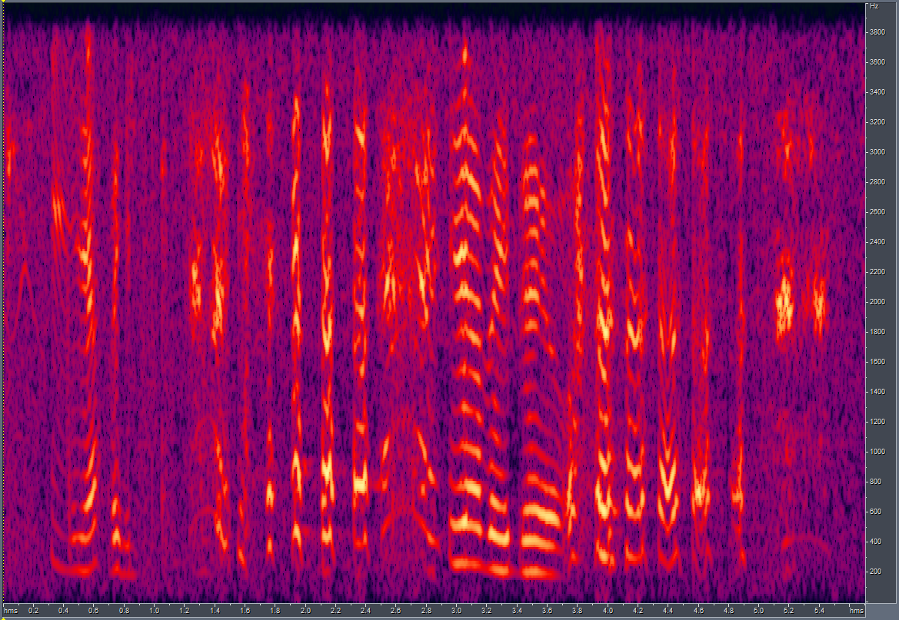
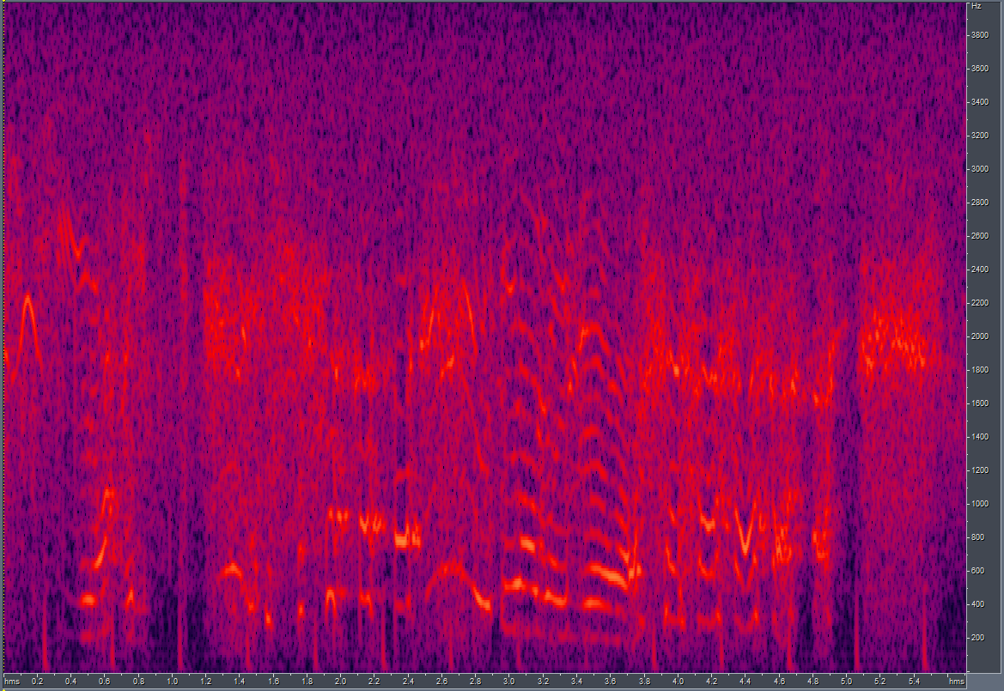
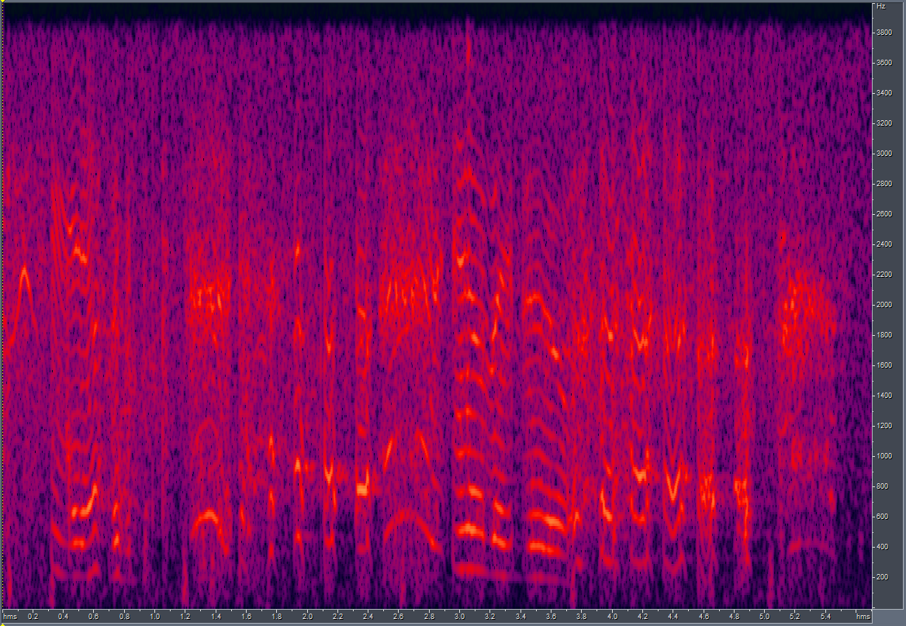
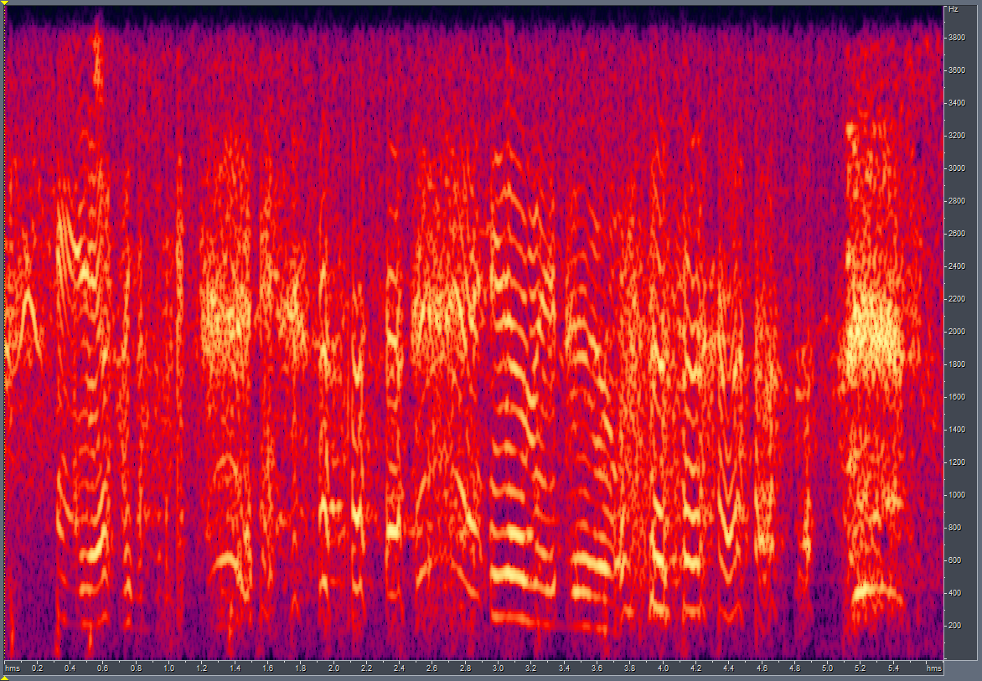
Results of the experiments (II):
Channel G
LSD (Before): 8.36; LSD (New): 8.65
Channel H
LSD (Before): 7.96; LSD (New): 7.87
GT
O/P – same speaker
O/P – OLD
GT
O/P – same speaker
O/P – OLD
GT
O/P – same speaker
O/P – OLD
GT
O/P – same speaker
O/P – OLD

Slide 6
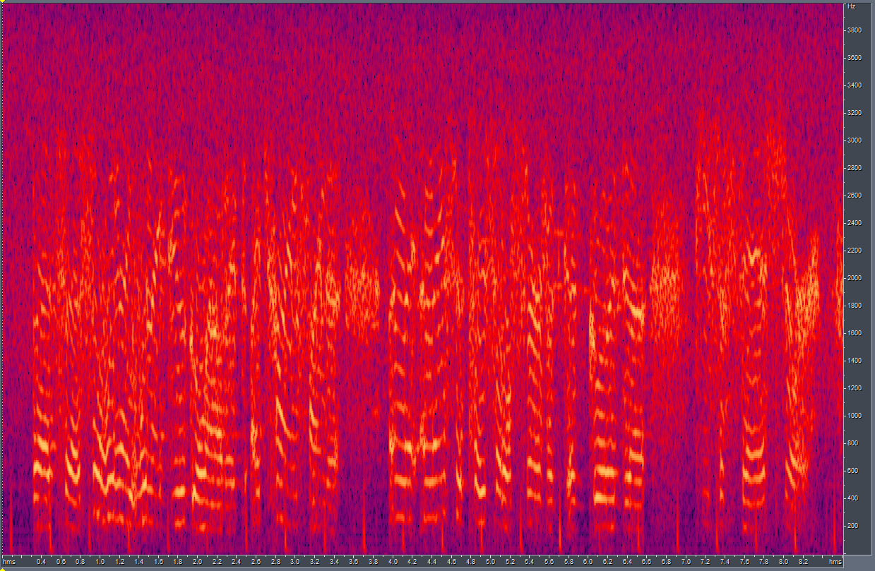
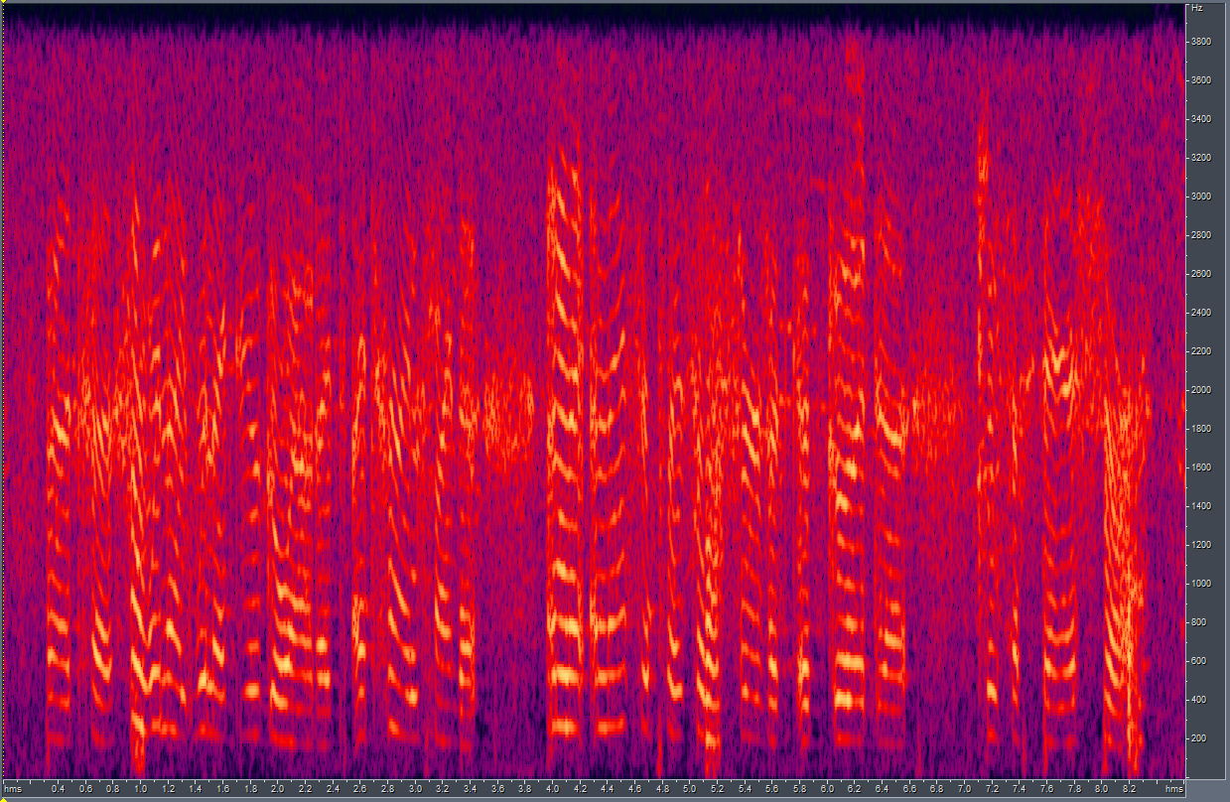
Results of the experiments (III):
Here, we also document:
The impact of normalization before training.
The performance of the model using parallel training samples (same content)
Results:
Non-parallel samples; No Normalization;
LSD = 8.83
GT
OP

Slide 7
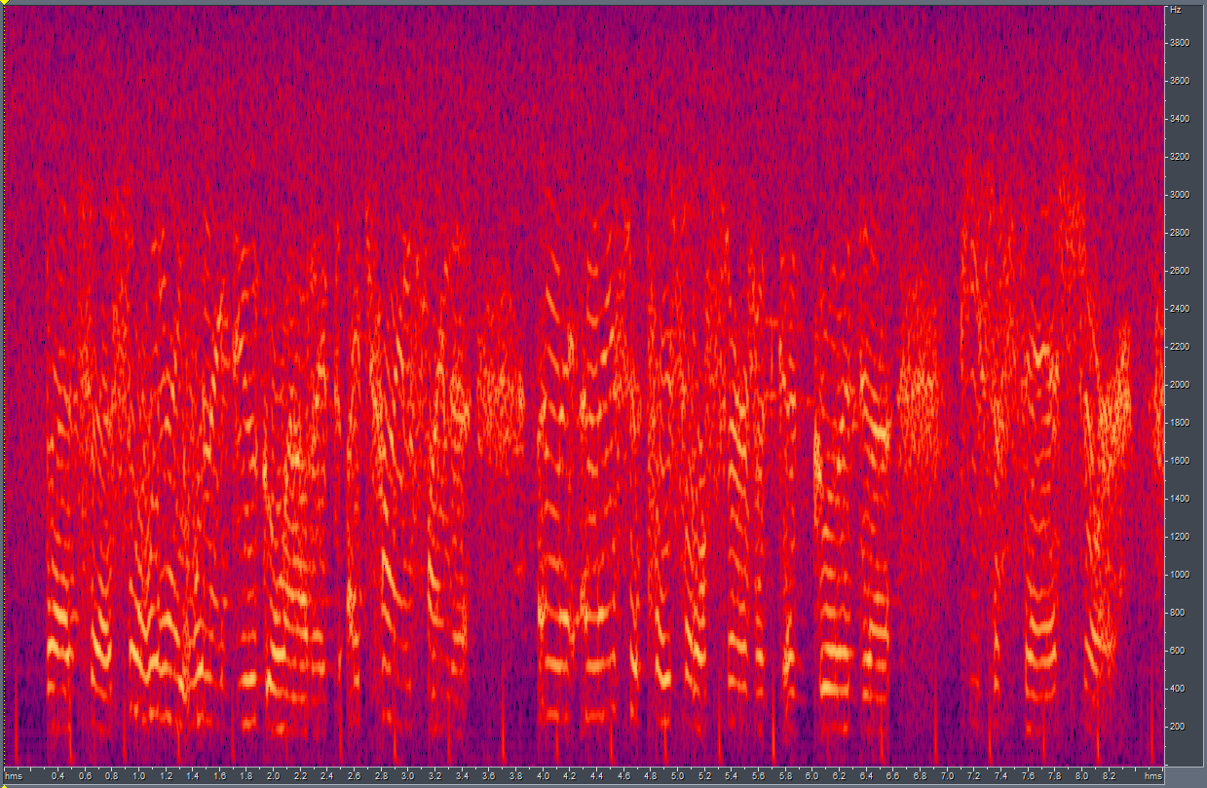
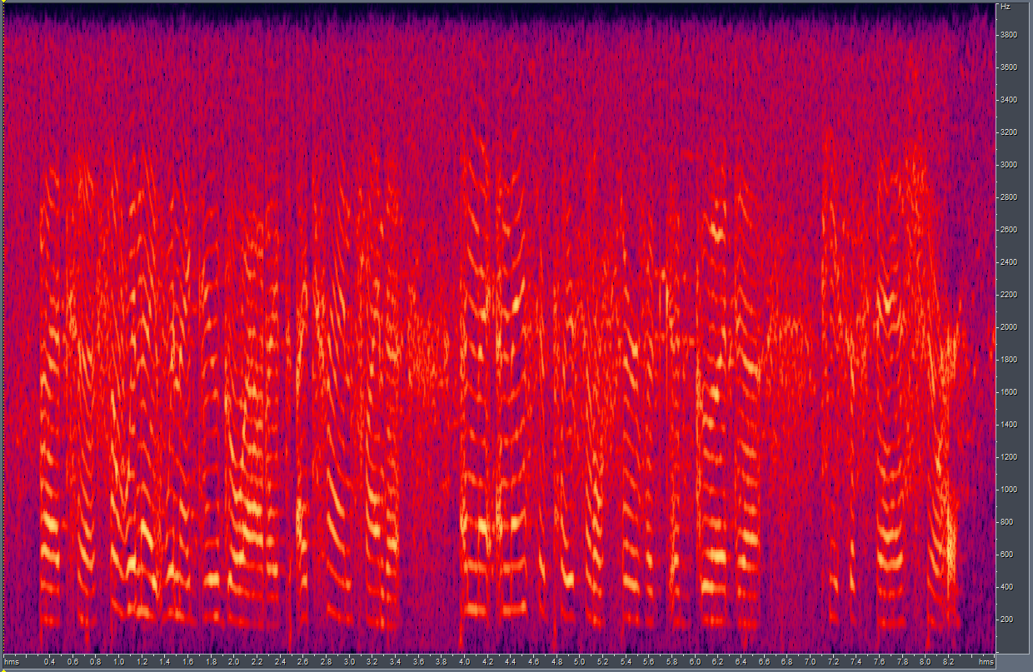

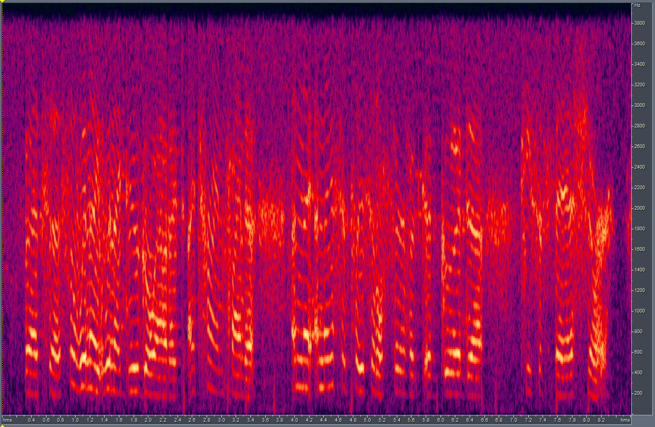
Results of the experiments (IV):
Parallel Samples; No normalization;
Parallel Samples; with Normalization;
LSD = 7.89
GT
OP
LSD = 10.56 ?
GT
OP

Slide 8
The Paper
Made efforts towards writing the paper. Compiled a list of relevant works, created illustrations for the project, devised experiments, etc.
For the next part of the presentation, we will head to the current draft of the paper.

Slide 9
End.

